Slide 1

Nutrient availability increases leaf nitrogen at the expense of whole plant growth in a closed canopy temperate forest
Evan A. Perkowski¹; David W. Frey²; Christine L. Goodale²; Nicholas G. Smith¹
¹Dept. of Biological Sciences, Texas Tech University
²Dept. of Ecology and Evolutionary Biology, Cornell University

Slide 2
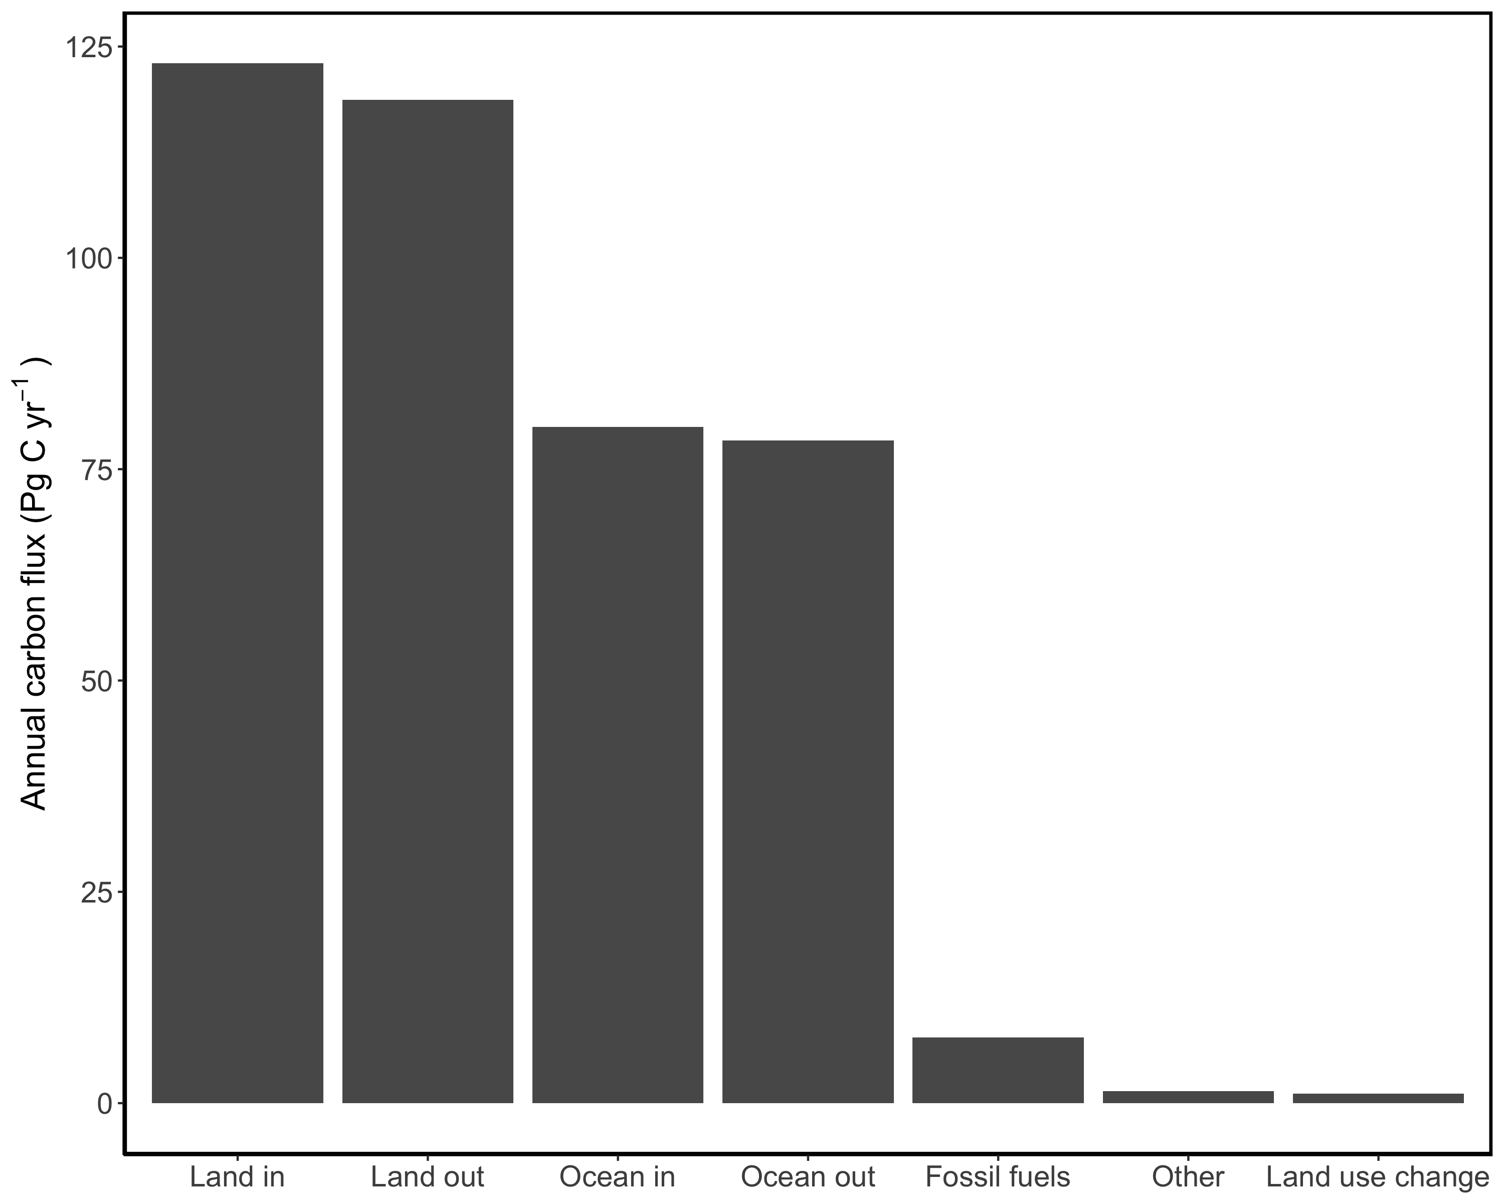
Adapted from IPCC, 2013
Notes:
We need to know what these fluxes are to get the global carbon budget
1% change in land in is much greater than 1% change in fossil fuels

Slide 3
Photosynthesis represents the largest carbon flux between the atmosphere and land surface
ESMs must accurately represent photosynthetic processes
PHOTOSYNTHESIS
Adapted from IPCC, 2013
Notes:
We need to know what these fluxes are to get the global carbon budget
1% change in land in is much greater than 1% change in fossil fuels

Slide 4
Soil resource availability
Leaf nutrient content
Photosynthetic capacity
Leaf-level photosynthesis
Terrestrial biosphere models indirectly predict photosynthetic capacity from soil nitrogen availability
Notes:
Which means that TBMs indirectly predict photosynthetic capacity and leaf-level photosynthesis from soil resource availability

Slide 5
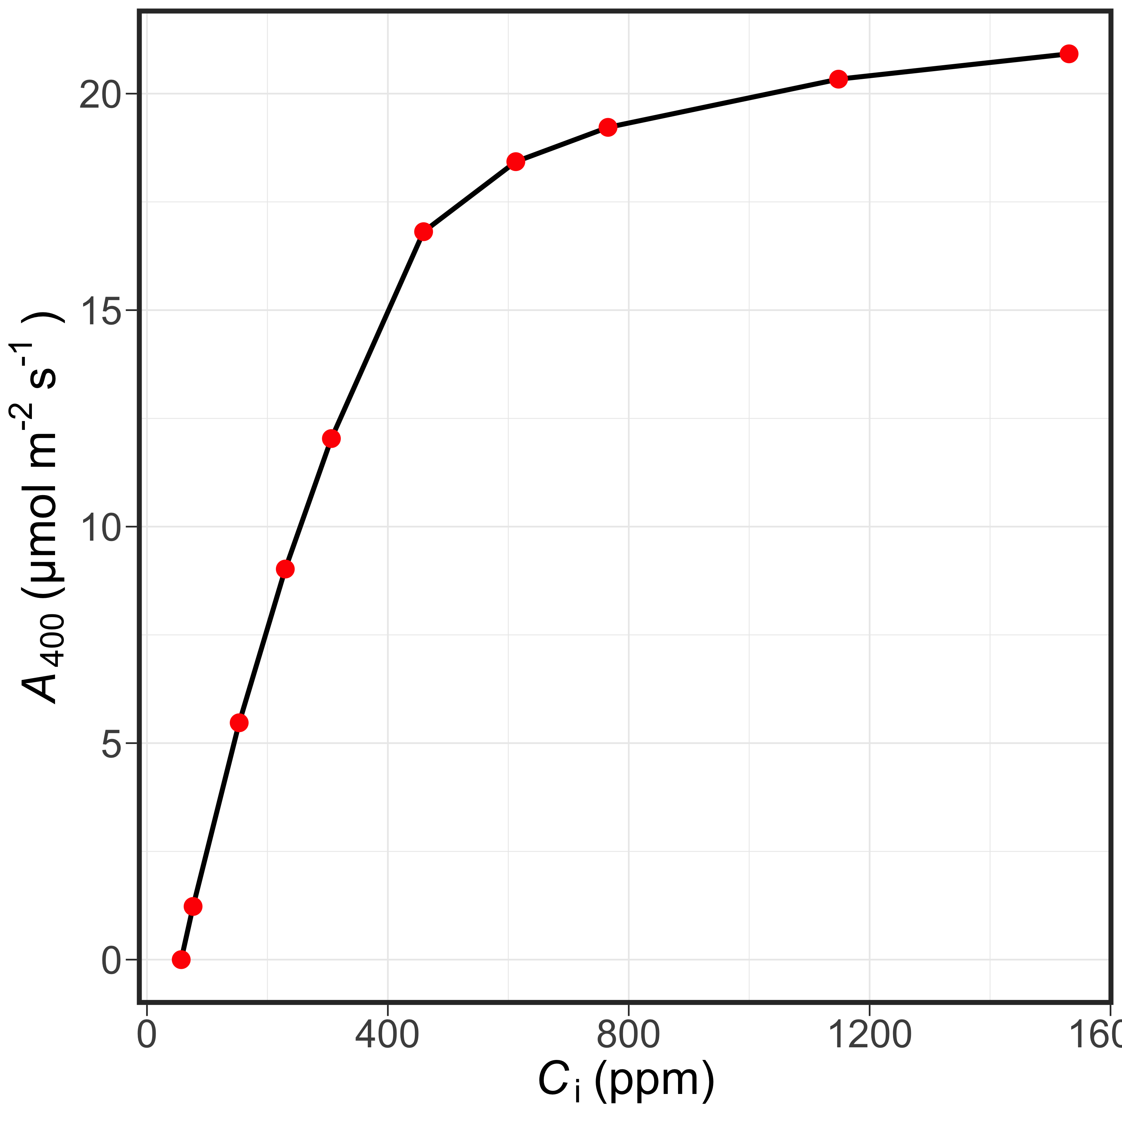
However, there are a few problems with these assumptions

Slide 6
However, there are a few problems with these assumptions
Notes:
This is an A-Ci curve, which is a common curve used in plant physiology.
Intercellular CO2 on the X, net photosynthesis on the Y
Generally, as intercellular CO2 concentrations increase, net photosynthesis increases.
But, there’s an evident “flattening” of the curve.
This is because photosynthesis is limited by two primary ways: CO2 and light

Slide 7
However, there are a few problems with these assumptions
CO₂-limited
Notes:
CO2 limited photosynthesis occurs when the curve is essentially linearly increasing
More Rubisco/photosynthetic machinery than required to fix CO2
As intercellular CO2 concentrations increase, there gradually becomes a point where Rubisco concentrations equal that of intercellular CO2

Slide 8
However, there are a few problems with these assumptions
light-limited
CO₂-limited
Notes:
Light limited photosynthesis occurs when the curve “flattens out”
When Rubisco concentrations become less than that of intercellular CO2, photosynthesis becomes increasingly limited by light
Photosynthetic machinery tends to be nitrogen rich
If more nutrients are allocated toward photosynthetic leaf tissue without concurrent increase in demand to allocate nutrients (e.g., increase in light), then the intercellular CO2 transition point between CO2 and light limited photosynthesis decreases, causing photosynthesis to become increasingly more light limited

Slide 9
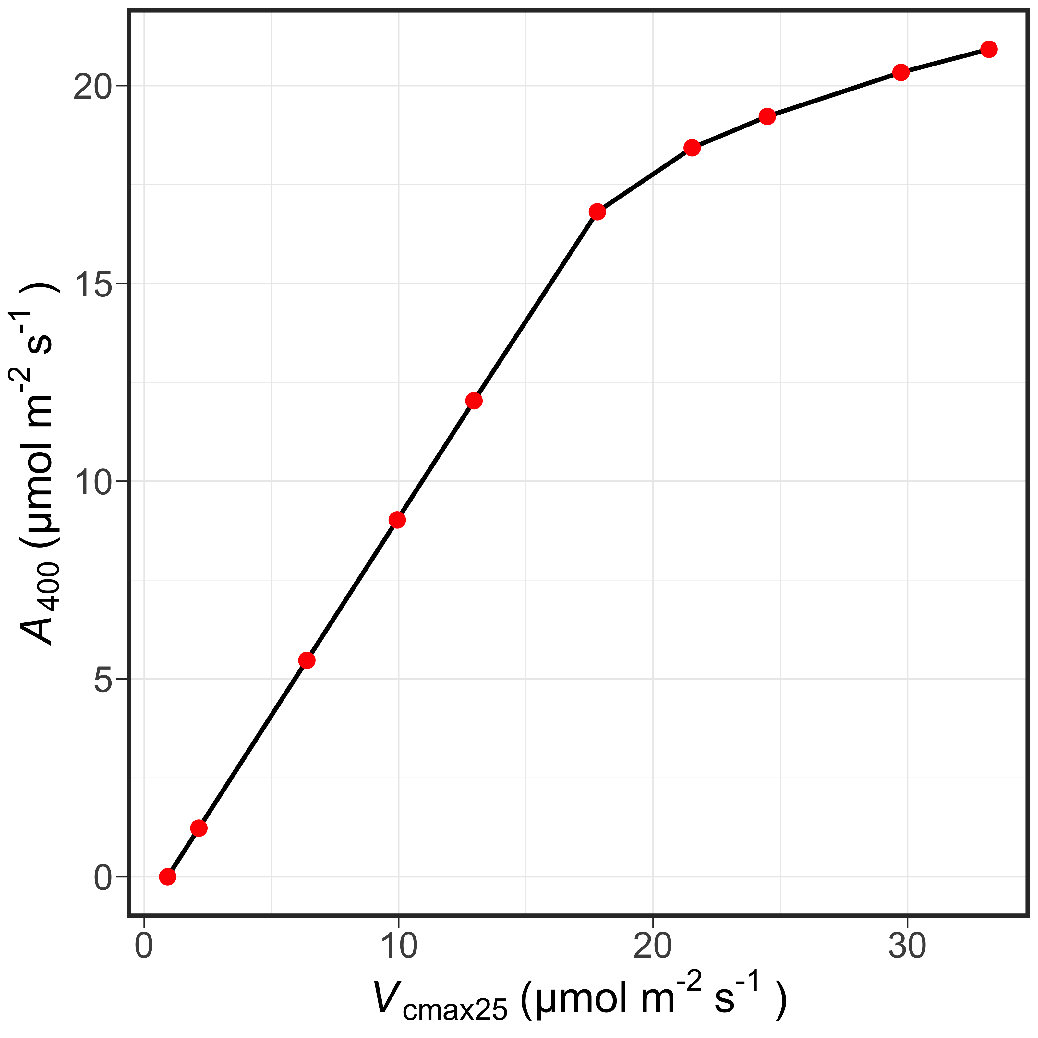
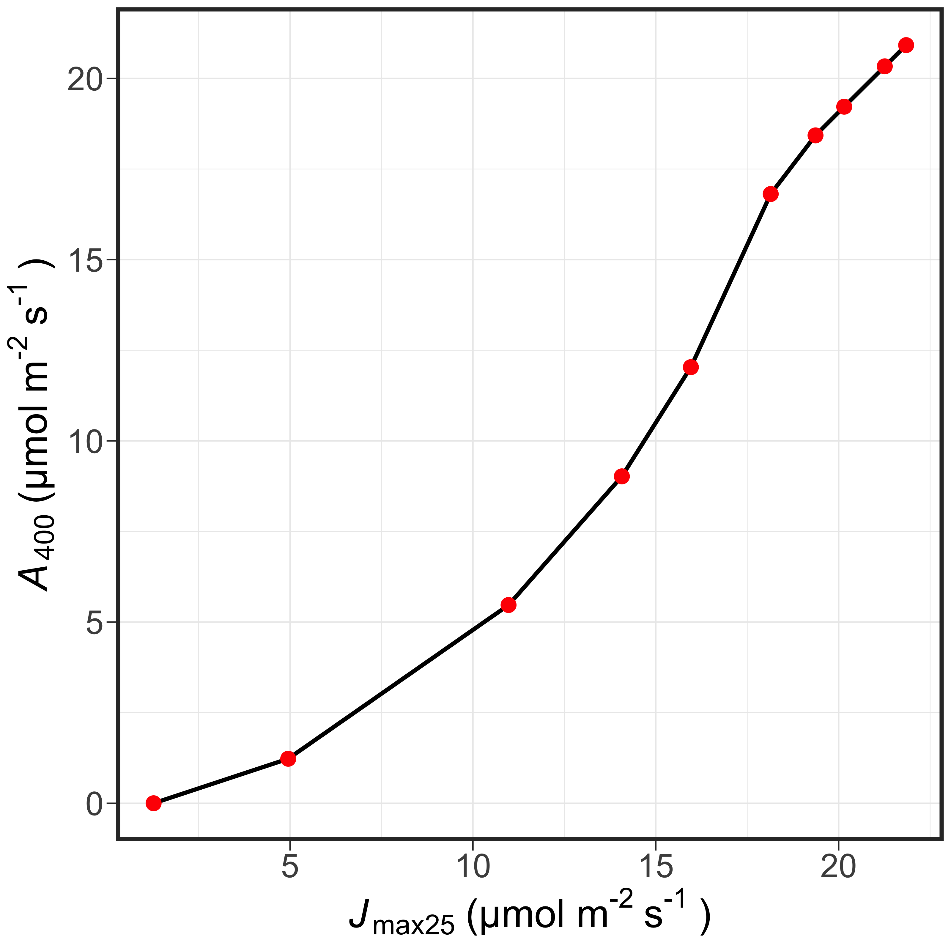
However, there are a few problems with these assumptions

Slide 10
However, there are a few problems with these assumptions

Slide 11
However, there are a few problems with these assumptions

Slide 12
Where is the nitrogen going?

Slide 13
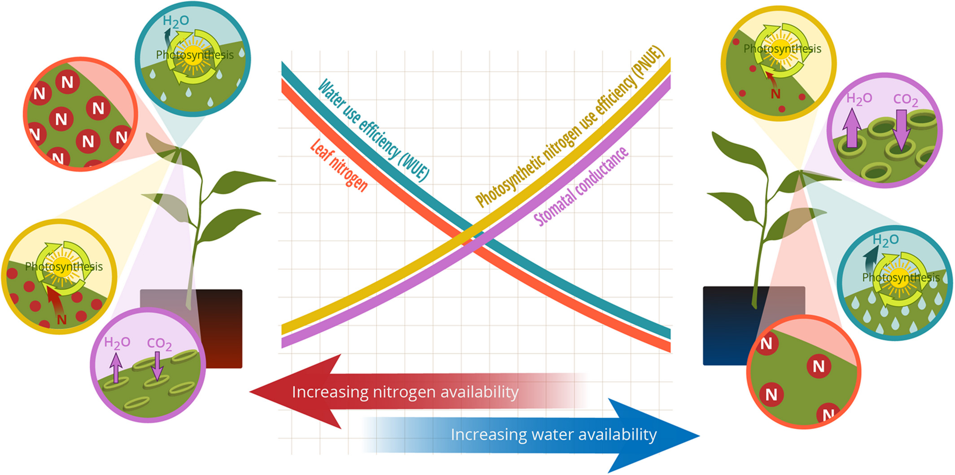
Option #1: Maintain photosynthesis with greater water-use efficiency at expense of photosynthetic nitrogen-use efficiency
Bialic-Murphy et al. (2021) Ecol. Letters

Slide 14
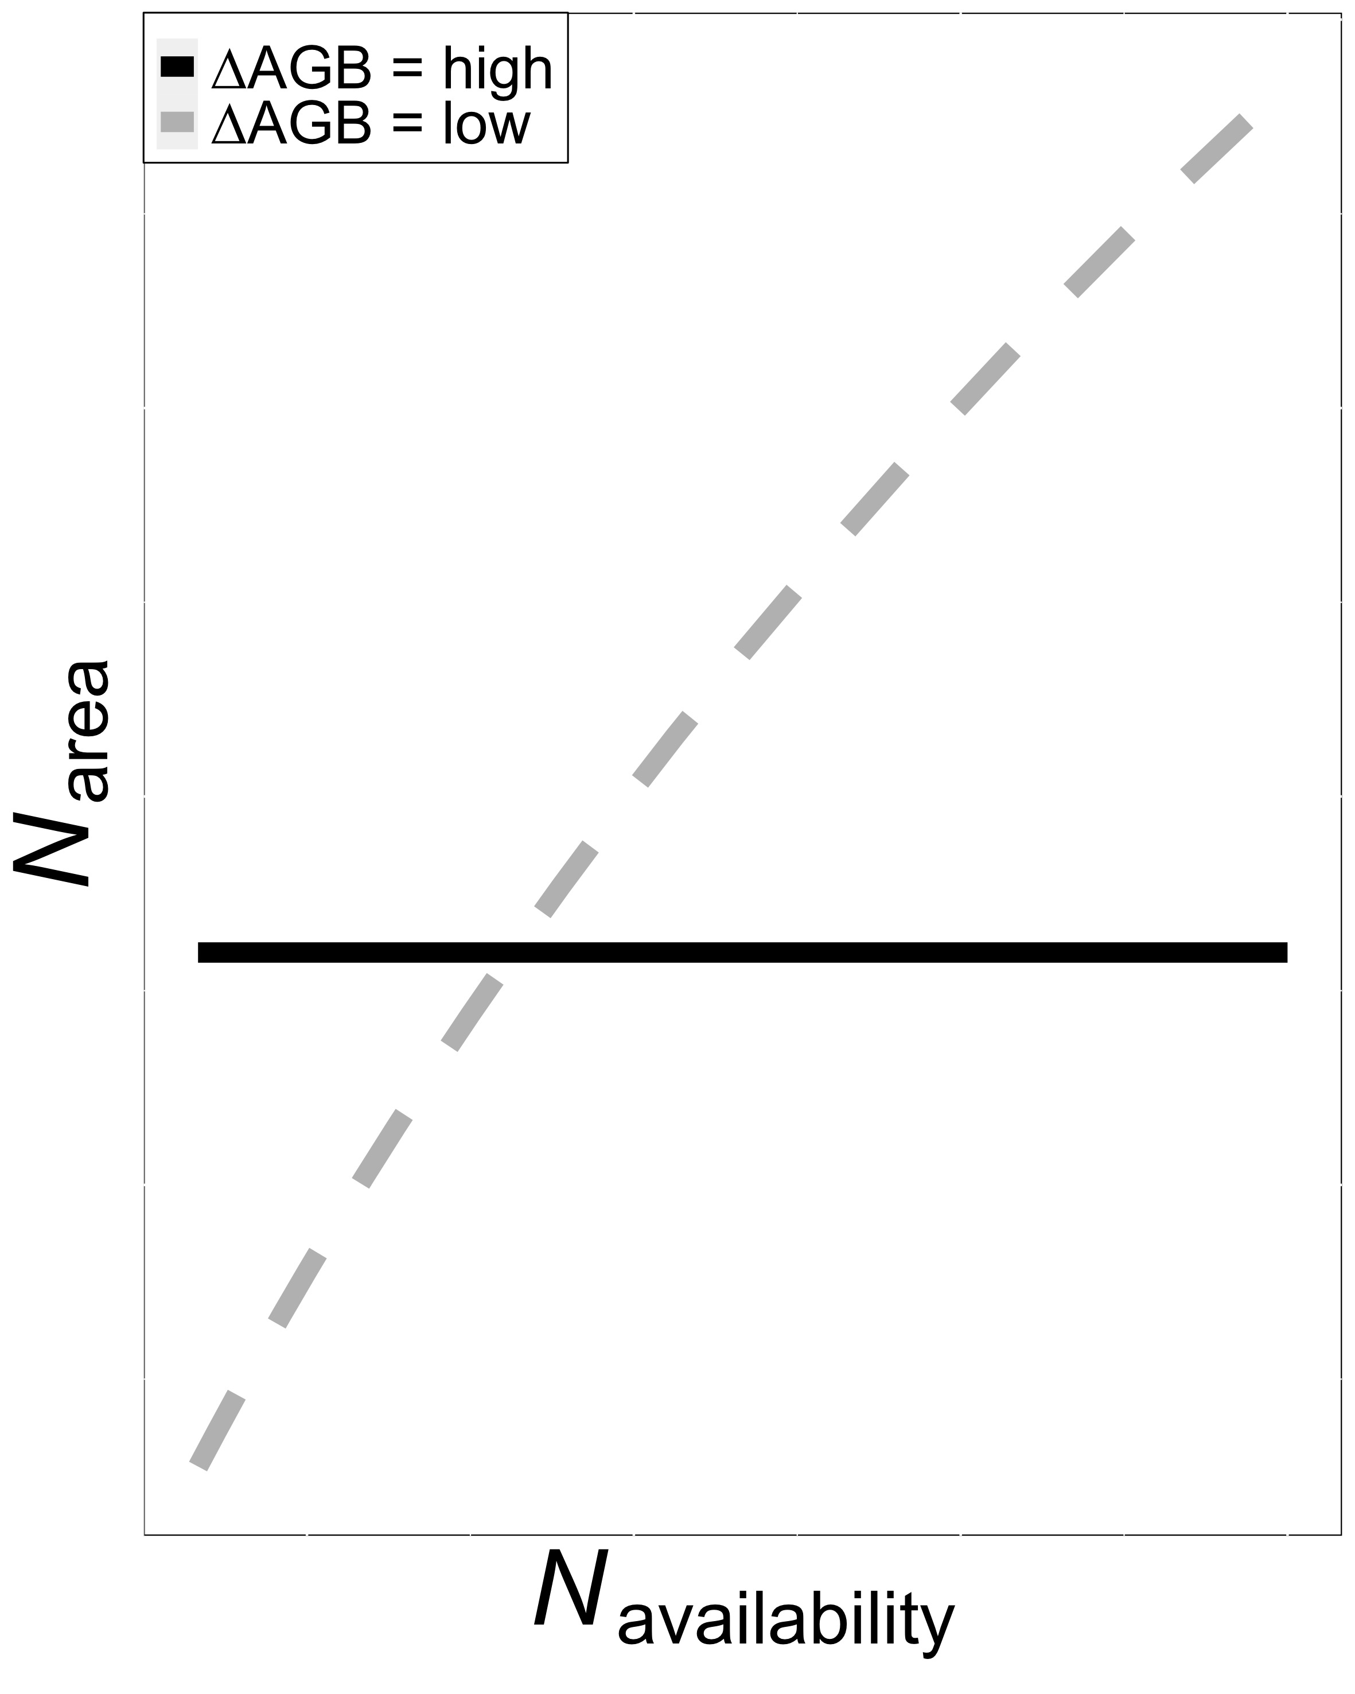
Option #2: Invest extra nitrogen toward whole plant growth at expense of leaf nitrogen, or vice versa
Smith et al. (in prep)

Slide 15
Very few manipulative studies investigate leaf and whole plant responses to changes in soil nutrient availability
Notes:
Most photosynthetic least-cost outcomes evaluated on gradient scale

Slide 16
Study Question
How do leaf and whole plant processes respond to soil nutrient availability in a closed canopy system?

Slide 17
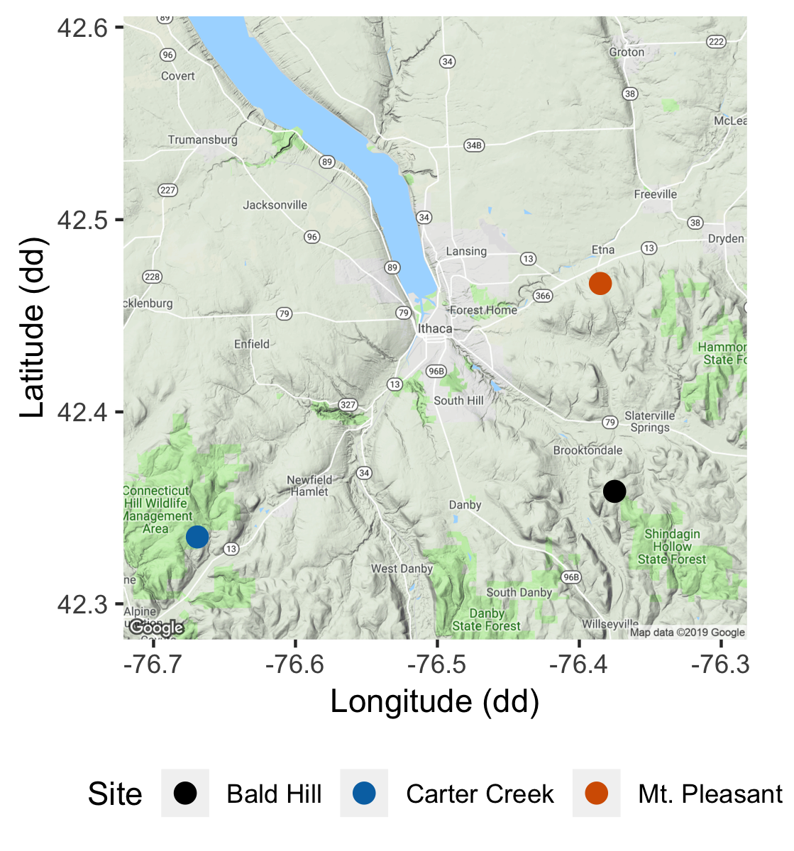
Study system
Soil fertilization treatments
Sites
0 kg ha⁻¹ yr⁻¹ N; 0 kg ha⁻¹ yr⁻¹ S
Bald Hill
0 kg ha⁻¹ yr⁻¹ N;
57 kg ha⁻¹ yr⁻¹ S
Mount Pleasant
50 kg ha⁻¹ yr⁻¹ N;
0 kg ha⁻¹ yr⁻¹ S
Carter Creek
50 kg ha⁻¹ yr⁻¹ N; 57 kg ha⁻¹ yr⁻¹ S
Notes:
3 sites within 15 km radius of Ithaca, NY

Slide 18
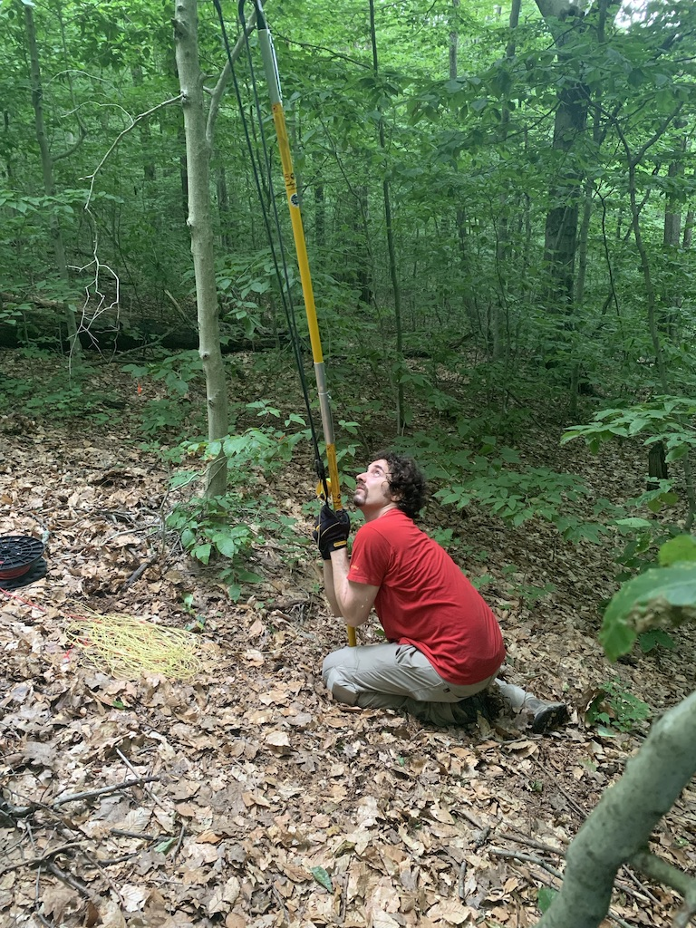
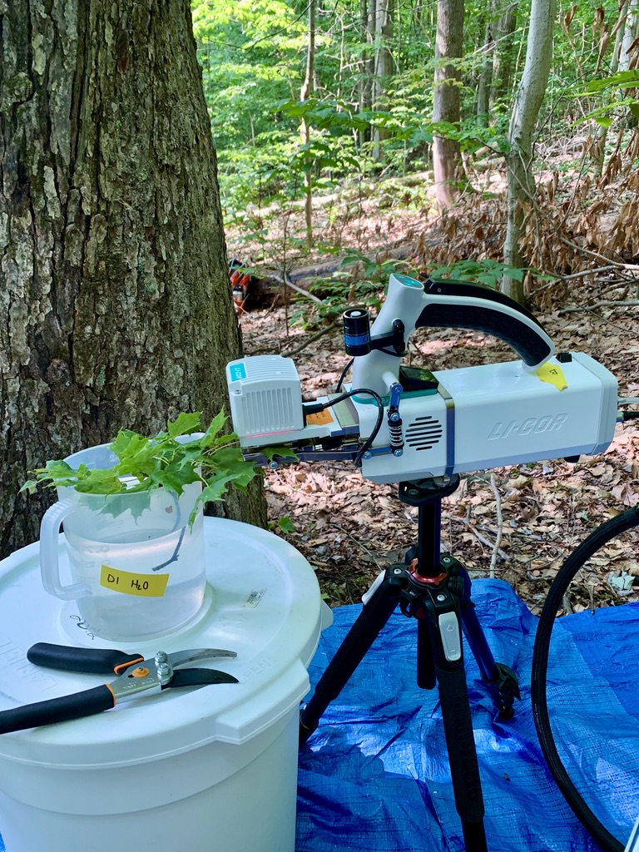
Leaf sampling
Fully sunlit canopy leaves brought down with arborist’s slingshot
Branches recut underwater
CO₂ response curve using LI-COR 6800

Slide 19
Plant measurements
Leaf-level measurements
Whole plant measurements
Net photosynthesis and biochemical process rates
Leaf nitrogen per unit leaf area
Specific leaf area
Stomatal conductance
Foliar δ¹³C (water-use efficiency)
Stomatal limitation
ΔDBH between 2011 and 2019
Relative growth rate using allometrically-scaled whole tree biomass
Leaf litter biomass (?)

Slide 20
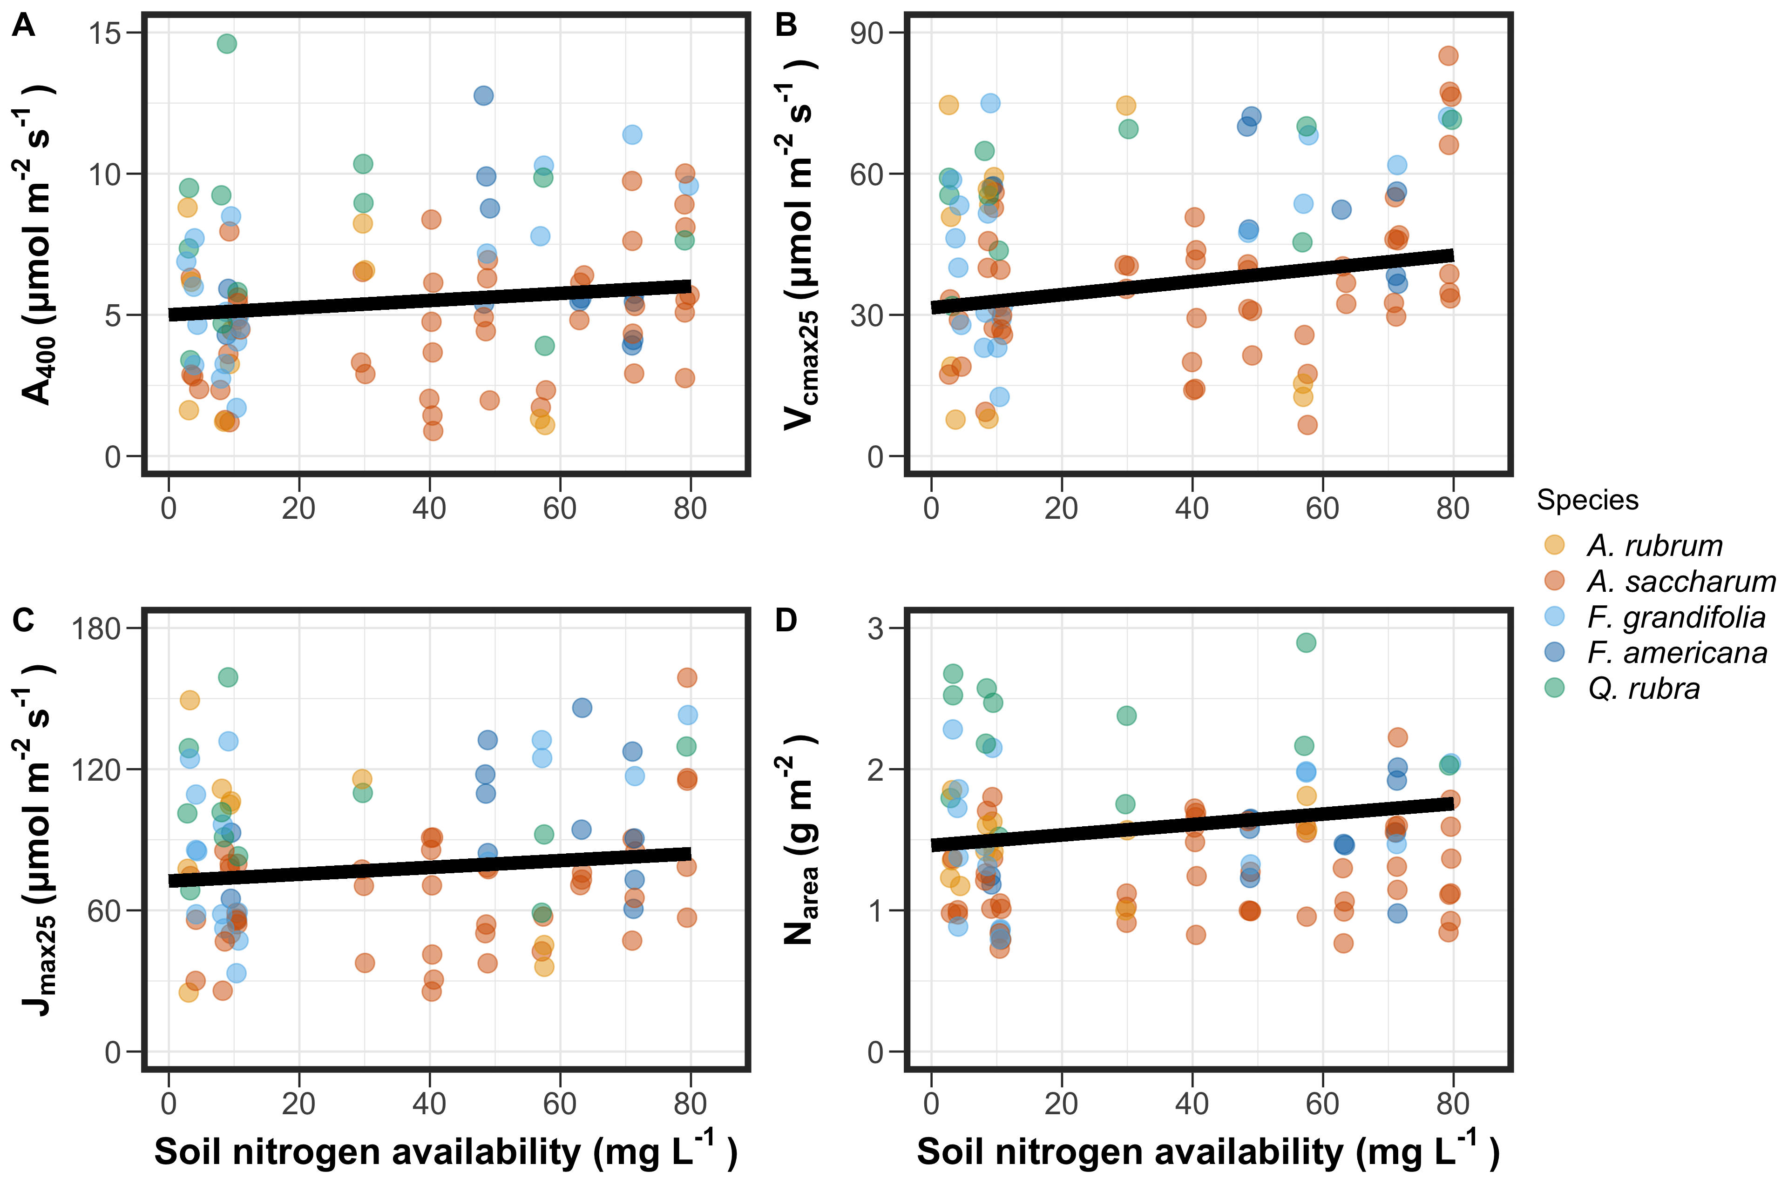
Soil N increases leaf-level photosynthesis

Slide 21
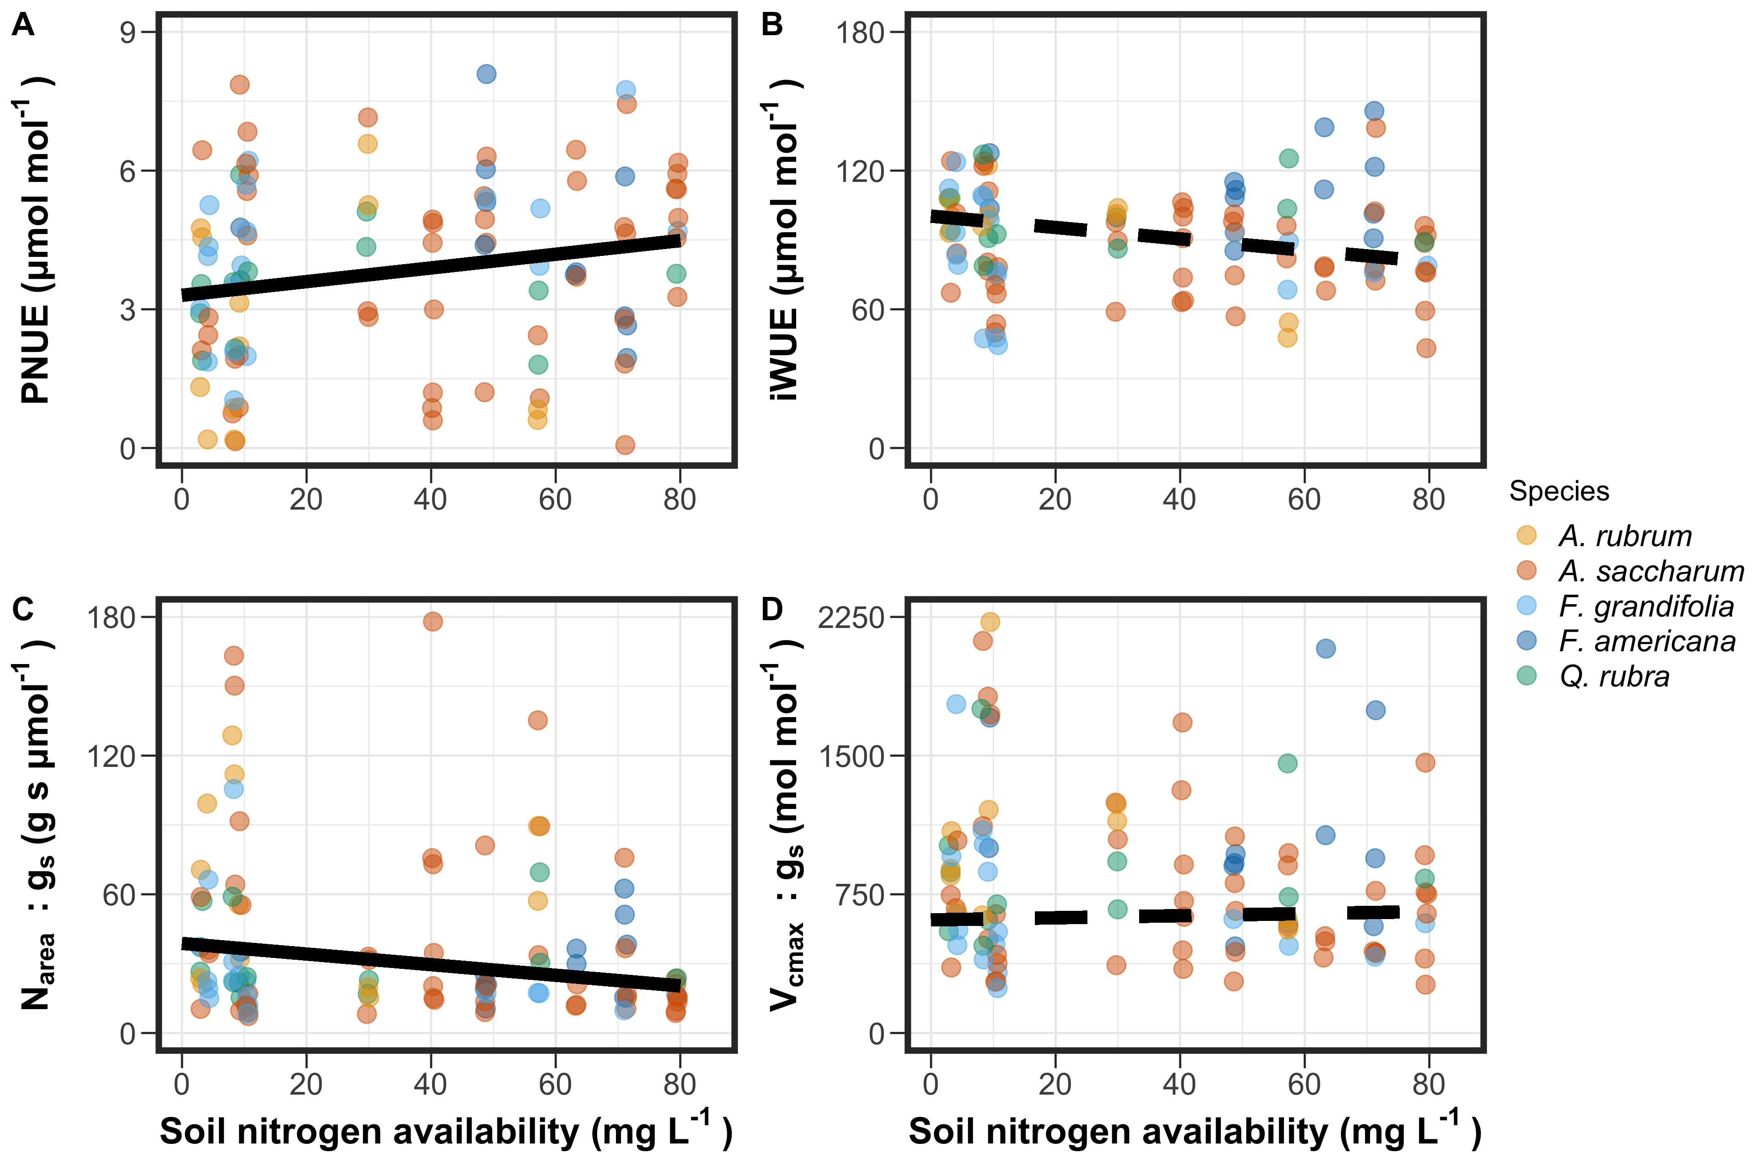
Soil N increases nitrogen-use efficiency, but does not influence water-use efficiency

Slide 22
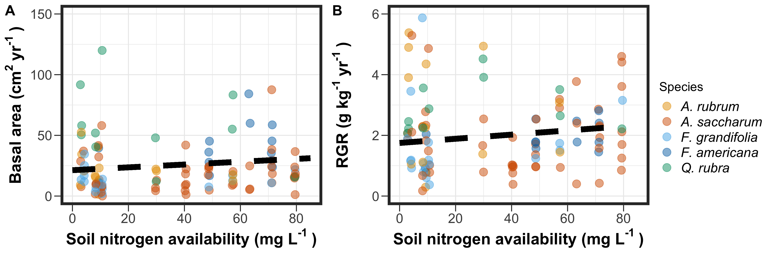
Soil N does not influence measures of whole plant growth

Slide 23
Revisiting Option 1
Did soil N allow photosynthesis rates to be achieved with higher water use efficiency at the expense of nitrogen-use efficiency?
Bialic-Murphy et al. (2021) Ecol. Letters

Slide 24
Revisiting Option 1
Did soil N allow photosynthesis rates to be achieved with higher water use efficiency at the expense of nitrogen-use efficiency?
No, increased soil N increased nitrogen-use efficiency and did not influence water-use efficiency
Bialic-Murphy et al. (2021) Ecol. Letters

Slide 25
Revisiting Option 2
Did soil N invoke tradeoffs between biomass production and N_{area}?
Smith et al. (in prep)

Slide 26
Revisiting Option 2
Did soil N invoke tradeoffs between biomass production and N_{area}?
Yes! Soil N did not influence whole plant growth, but increased N_{area}.
Smith et al. (in prep)

Slide 27
Discussion
Soil N increased leaf-level photosynthesis through an increase in N_{area}
However, soil N did not influence tradeoffs between nitrogen or water use efficiency, nor whole plant growth
Additional empirical evidence suggesting that there are tradeoffs between biomass production and leaf-level photosynthesis

Slide 28
Acknowledgements
USDA NIFA Award 2015-67003-23485
Texas Tech University
Risa McNellis (TTU)
Omair Irfan (Cornell)
Romin Abdolahzadi (Cornell)
Members of Schwilk & van Gestel labs (TTU)
Dr. Lizz Waring (TTU)
Notes:
Abdola-zadi

Slide 29
Thank you!

